Slide 1

US COUNTIES: COVID19 + WEATHER + SOCIO / HEALTH DATA
Deep Dive
DAB 304: Healthcare Analytics

Slide 2

OUR IDEA
A catastrophe was triggered by the COVID-19 epidemic worldwide. We aim to use machine learning models to forecast future Covid cases, the disease's trend, and predict its growth using US Counties: COVID19 + Weather + Socio/Health data dataset as the data indicates that there is an inverse association between temperature and the number of cancer cases.

Slide 3



PROJECT OVERVIEW
Literature Review This information comes from a public dataset: US Counties: COVID19 + Weather + Socio/Health data. It provides daily positive cases and fatalities for all 3,142 counties in the United States, as well as other daily statistics about each county's social, economic, health, and environmental circumstances. According to the statistics, there is an inverse link between temperature and covid instances.
Concepts Our machine learning (ML) model combines least squares regression, XGBoost, and neural networks. All of these machine learning models were applied to see the relationship between temperature and the covid cases. The neural network and XGboost models outperformed the linear regression methods.
Machine Learning We utilized Python code to import, clean, explore, and visualize data and train and validate the three machine learning models.

Slide 4
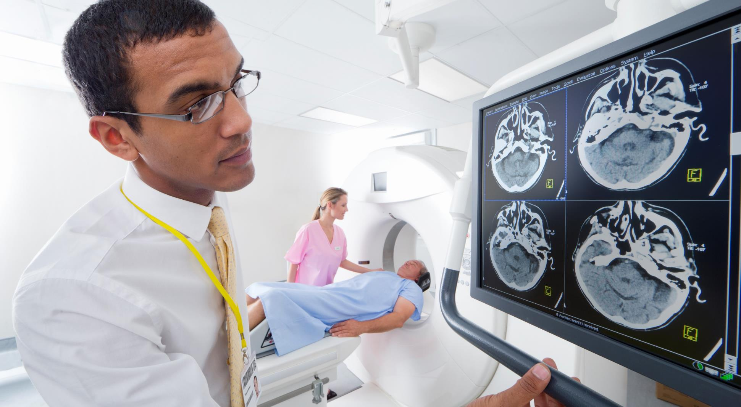




project LIFE CYCLE
Covid-19
ETL
Data modelling
prediction
Understanding the project's goal and choosing the dataset
Data extraction, transform and load
Performing descriptive & predictive modelling using machine learning
Predicting future daily cases of covid 19
Success

Slide 5
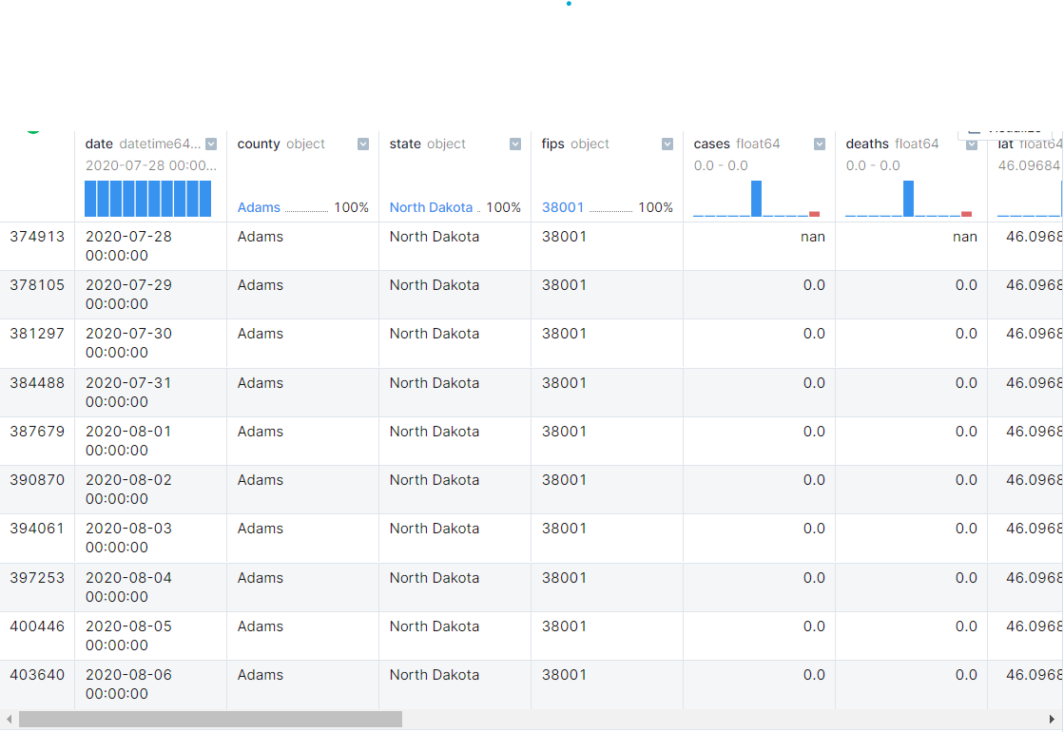
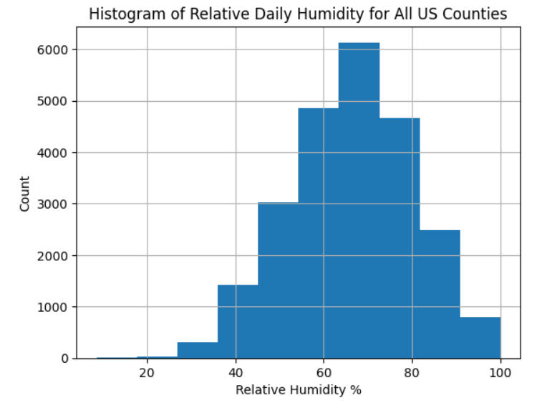
Preliminary data visualization

Slide 6
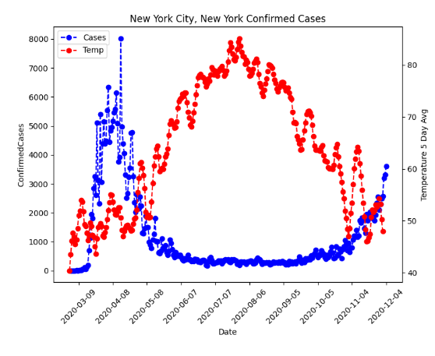
New York city
CONFIRMED CASES BASED ON TEMPERATURE & HUMIDITY :
You can clearly see the trend with temperature: as the average temperatures increased during the summer, the number of new cases went down.

Slide 7
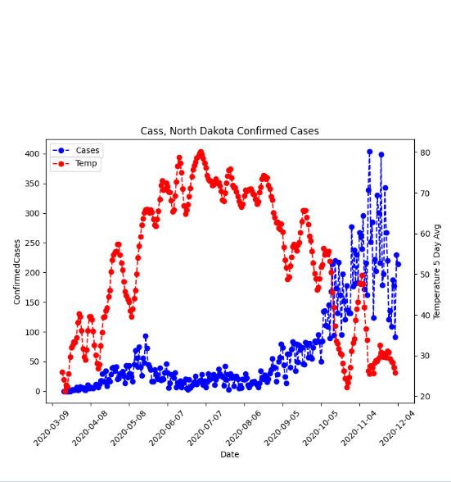
NORTH DAKOTA
CONFIRMED CASES BASED ON TEMPERATURE & HUMIDITY :
You can clearly see the trend with temperature: as the average temperatures increased during the summer, the number of new cases went down.

Slide 8

Machine learning model
Ordinary least square Linear Regression
XGBoost MODEL
Ordinary Least Squares (OLS) linear regression is a statistical technique used for the analysis and modelling of linear relationships between a response variable and one or more predictor variables. If the relationship between two variables appears to be linear, then a straight line can be fit to the data in order to model the relationship.
XGBOOST is a supervised machine learning model that deals with independent data points. It assumes that each data point is totally independent from the rest of the data points in the dataset. Clearly, the number of cases from the previous day helps predict cases in the days ahead. It is possible that the previous data will be linked to the current data. The features method does this by adding columns of data that relate the current row of data to past data.
Neural Network
Neural network (NN) This model predicts the patterns and they are designed after human brain.

Slide 9
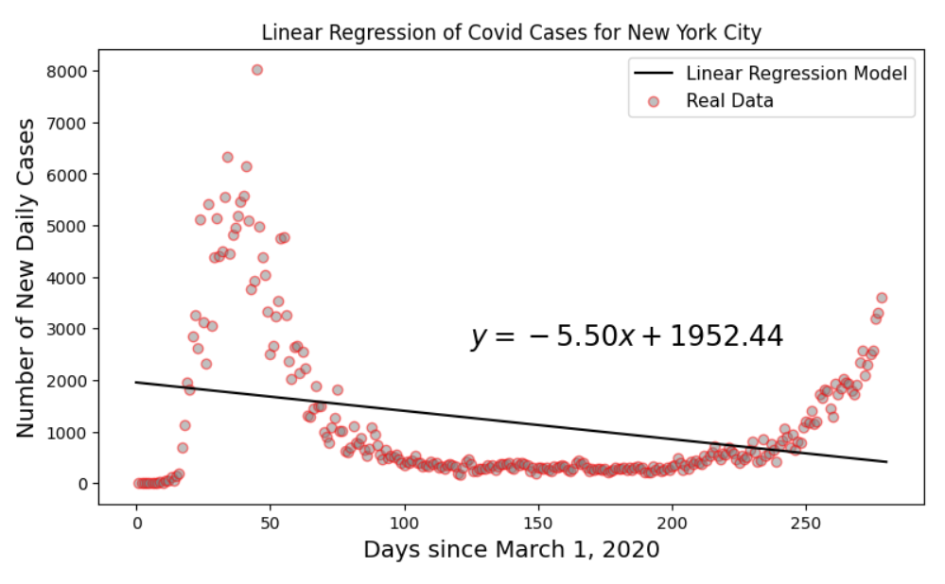
Linear regression
As shown in the above plot, the straight line of the linear regression does not do well with seasonal data.

Slide 10
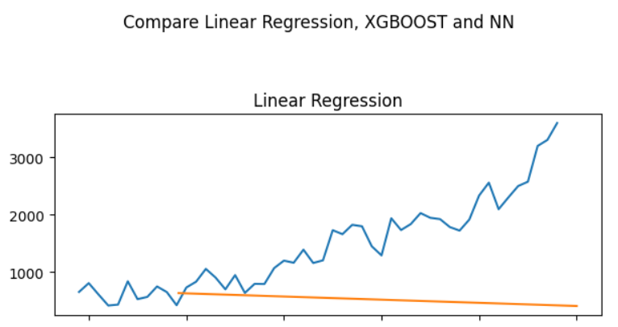
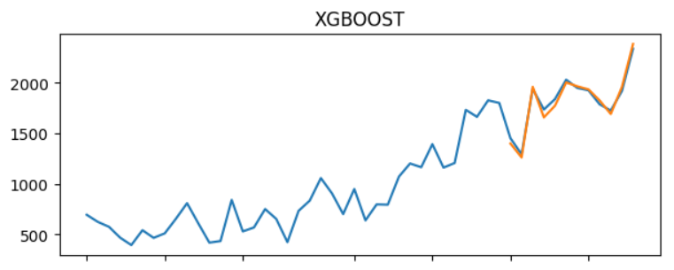
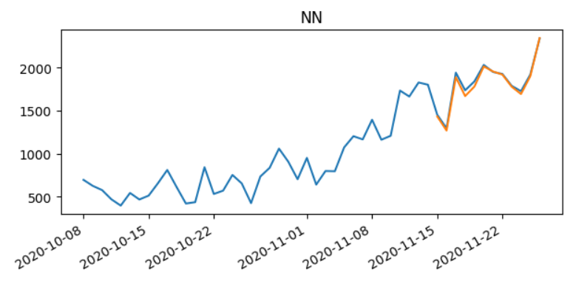
MODEL prediction
Linear Regression v/s XGBOOT v/s Neural Network

Slide 11
Conclusion
XGBOOST and the NN can accurately predict the number of new covid cases in New York City for 20 days into the future from November 15 to December 4, based on a training set with data from the beginning of March until November 15, 2020. Those two algorithms use the features to predict the number of new daily cases.

Slide 12

Thank you
Diksha
Siddharth Rajguru
Preet Chetan Patel

